Slide 1
Head of Faculty of Visual and Performing Arts
M/UPR £30,000 to £46,525 plus TLR1b £11,408 pa
Full Time, Permanent
CANDIDATE INFORMATION PACK

Slide 2
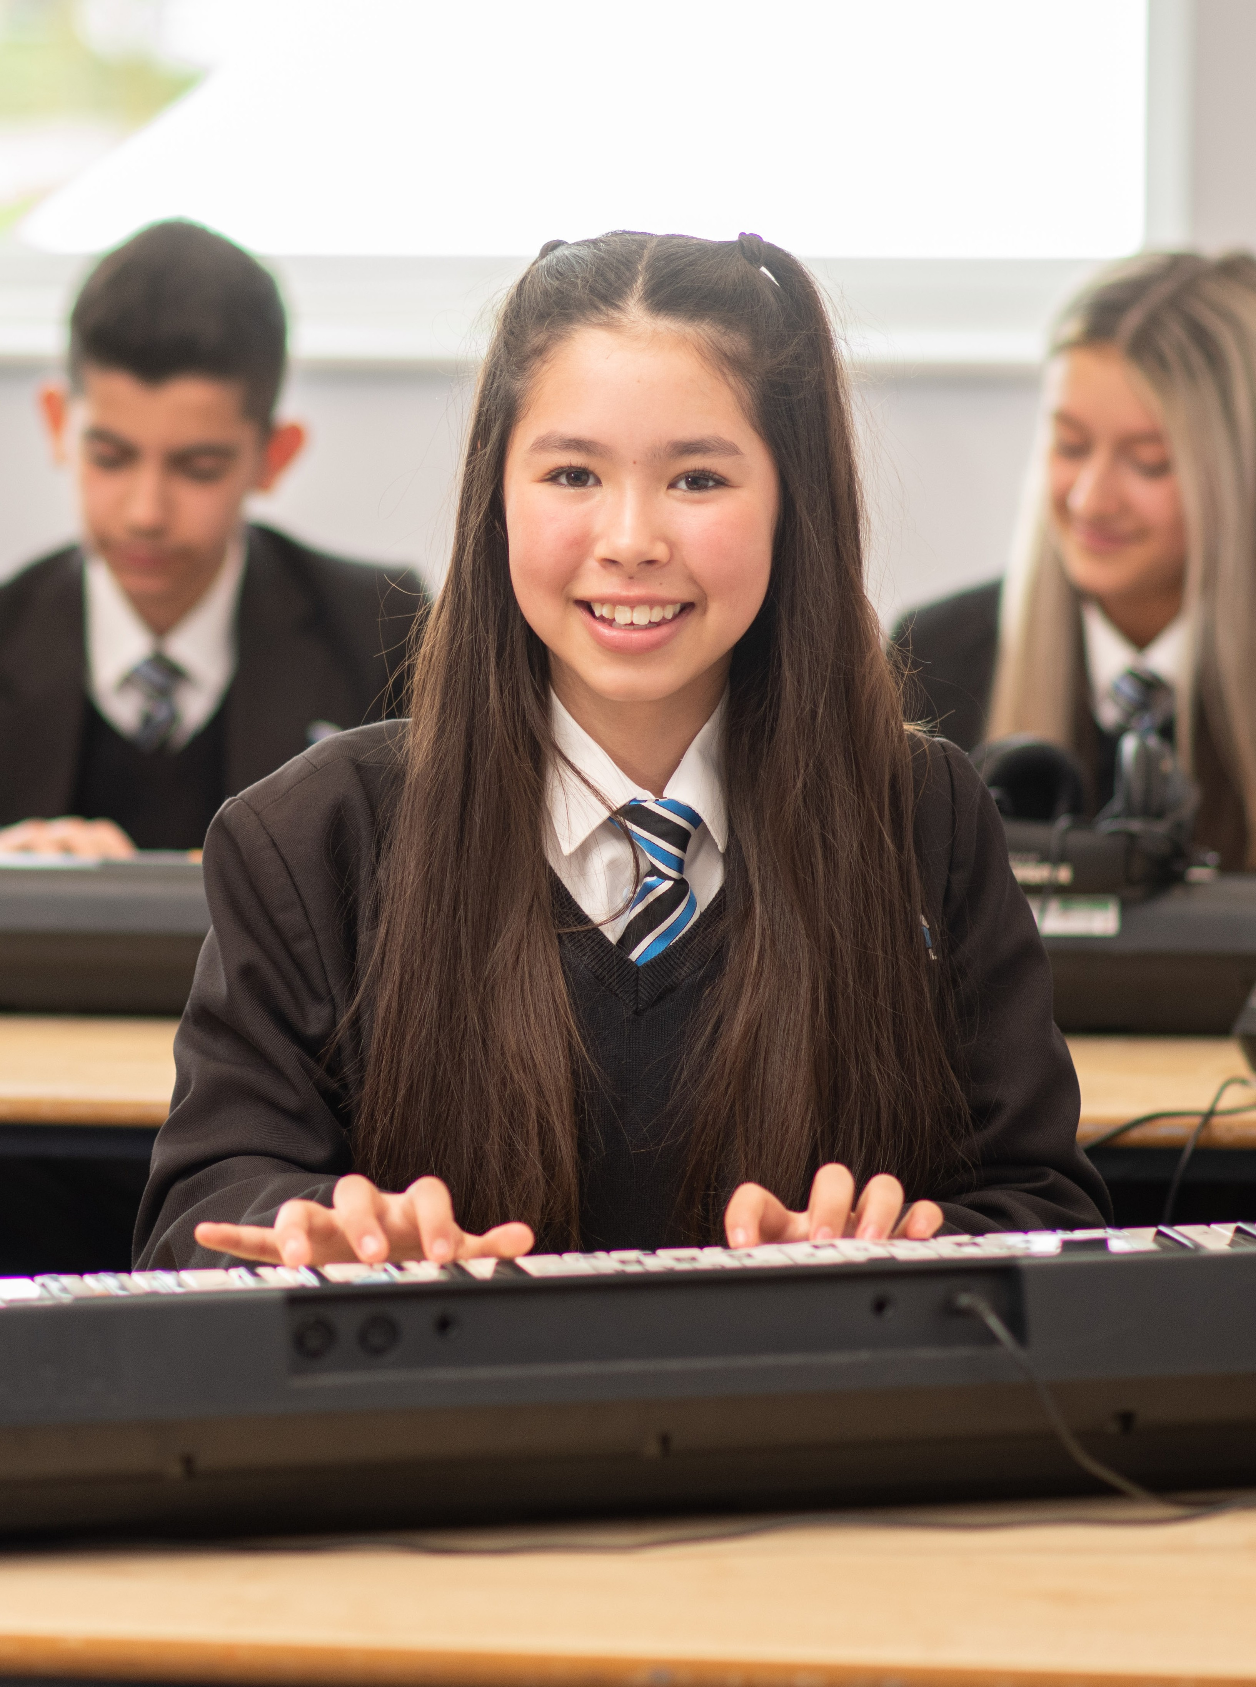
2

Slide 3
INTRODUCTION From the Principal r From the
Pay Range: L8-L12
Responsible to:
Vice Principal
Dear Applicant
Thank you for your interest in the above post. Kenton School is a vibrant and inclusive secondary school at the heart of the community in which we serve. With just 1800 students, we are amongst the largest schools in the Northeast. At Kenton we are clear about our vision; Students are at the centre of everything we do. Through collaboration, every aspect of our work is of high quality. Our academies deliver an ambitious and inclusive curriculum that enables all students to excel academically and socially.
Following promotion of the current postholder, we are seeking a Head of Faculty to join and lead our visual and performing arts department. This is an exciting role focussed on educational progress of learners within art, music, drama and performing arts. In addition, the role will include leading extra-curricular activities to meet course requirements and showcase students work, including ensuring a programme of school productions/performances and exhibitions.
If you are the person we are looking for you will be able to demonstrate:
A passion for all aspects of performing and visual arts.
Demonstrable experience driving performance improvements in your designated curriculum or core leadership area.
An ability to think and act strategically with sensitivity to organisational and wider political priorities to deliver high quality outcomes.
An ability to use data effectively and present views and opinions in discussion which contribute to positive outcomes including the ability to challenge, give feedback and accept feedback constructively.
A proven track record of effective people, resource and financial management or be able to demonstrate the ability to manage these areas.
Ability to demonstrate high expectations and to instill these in others.
In return we offer:
Salary sacrifice schemes such as childcare vouchers and cycle to work.
Access to free gym facilities on our Kenton School site.
Access to the Teachers' Pension Scheme
The opportunity to work in a fantastically resourced school with easy commuting access to both the A1 and A19, in a supportive team committed to the development of all our staff.
Yours sincerely
Julie Roberts
Acting Principal
5

Slide 4
Head of Faculty of Visual and Performing Arts Job Description
Pay Range: M/UPR
Responsible to:
Vice Principal
Job Purpose
To be accountable for educational progress of learners within the faculty by effectively leading teaching and learning, developing associated curriculum areas and managing staff, budget and resources
Key Accountabilities
The postholder will be accountable for the following:
Promoting the values and vision of the Trust and using them to inform decision-making
Performance of staff they lead against the criteria below
Outcomes of students at KS4 against the FFT 5th percentile of national target standards and KS 5 against the upper quartile of national performance standards
Quality of teaching and learning across the faculty as measured by:
Progress of students in subjects that can be reasonably expected against their previous starting points
Progress of students with SEND in subjects that can be reasonably expected against their previous starting points
Progress of students with EAL in subjects that can be reasonably expected against their previous starting points
Progress of Pupil Premium students in subjects that can be reasonably expected against their previous starting points
The design of the scheme(s) of study setting out the aims of a programme of study, including the knowledge and skills to be gained at each Key Stage
The design of teaching activities that lead to learning the knowledge and skills intended by the programmes of study
The design and delivery of intervention strategies to support students in making the progress which can be expected of them in subjects
The impact of reading and literacy programmes on standards of student competence
Participation rates of students in extra-curricula provision offered by the faculty in each year group are seen to be rising year-on-year
Standards of behaviour of students against the One Trust Rule in lessons
Main Responsibilities
The following list is typical of the level of duties which the post holder will be expected to perform. It is not necessarily exhaustive and other duties of a similar type and level may be required from time to time.
5

Slide 5
Lead Teaching and Learning Responsibilities
Lead and develop teaching and learning within the faculty by developing and implementing assessment strategies, data analysis and appropriate intervention programmes to ensure that identified standards of learner achievement are met.
Lead, develop and enhance the teaching practice of others through monitoring/evaluation and promoting improvement strategies to secure effective teaching and learning for learners.
Lead, manage and develop the curriculum to provide programmes/activities that match learner aspirations and potential and achieve excellence and enjoyment for learners.
Line manage a team of staff including the effective recruitment, appraisal and development of its members in order that the team’s objectives are achieved.
Manage allocated faculty budget and resources.
Facilitate an ethos within the team which encourages staff to work collaboratively, share knowledge and understanding, celebrate achievements and accept responsibility for outcomes.
Generic Teaching Responsibilities
To carry out the professional duties of a Teacher as set out in the School Teachers' Pay and Conditions Document and carry out teaching duties in accordance with the school's schemes of work and the National Curriculum.
Establish a purposeful and safe learning environment and manage learners’ behaviour constructively by establishing and maintaining a clear and positive framework for discipline and a supportive culture in line with the school behaviour policy.
Plan effectively in the short, medium and long-term and prepare effective learning sequences, lessons and work across a series of lessons to ensure coverage of the curriculum and the differentiated needs of learners are met. Plan and prepare homework and other out of class work.
Be aware of and apply a range of teaching and learning strategies, including implementing inclusive practices, to ensure that the diverse needs of learners are met and excellence and enjoyment is achieved. Deliver lessons to groups of learners or classes. Demonstrate the positive values, attitudes and behaviour expected from learners.
Assess, record and report on the development and progress of learners and analyse relevant data to promote the highest possible aspirations for learners and target expectations and actions to raise learners’ achievements. Provide timely, accurate and constructively feedback on learners’ attainment, progress and areas of development.
Demonstrate ongoing development and application of teaching practice, expertise and subject, specialism and/or phase knowledge to enrich the learning experience within and beyond the teacher’s assigned classes or groups of learners.
Communicate effectively and work collaboratively within and beyond the classroom with support staff (including directing their day-to-day work), teachers, other professionals, parents, carers, agencies and communities, to enhance teaching and learning and promote the positive contribution and well-being of learners.
Contribute to the development and implementation of priorities, policies and activities in order to enable the achievement of whole school aims.
To work effectively with / be aware of and assist integrated processes, and local opportunities which support children, young people and their families
Make significant contributions to implementing workplace policies and practice and to promote their implementation.
Promote collaboration between colleagues and contribute to their professional development through coaching and mentoring, demonstrating effective practice, and providing advice and feedback.
Promote the safeguarding and welfare of children and young persons the postholder is responsible for, or comes into contact with. Give advice on the development and wellbeing of children and young people, if required. Be aware of school policies and other guidance on the safeguarding and promotion of wellbeing of children and young people. Take appropriate action where required.
Promote and implement policies and practices that encourage mutual tolerance and respect for diversity in all aspects of employment and service delivery.
6

Slide 6
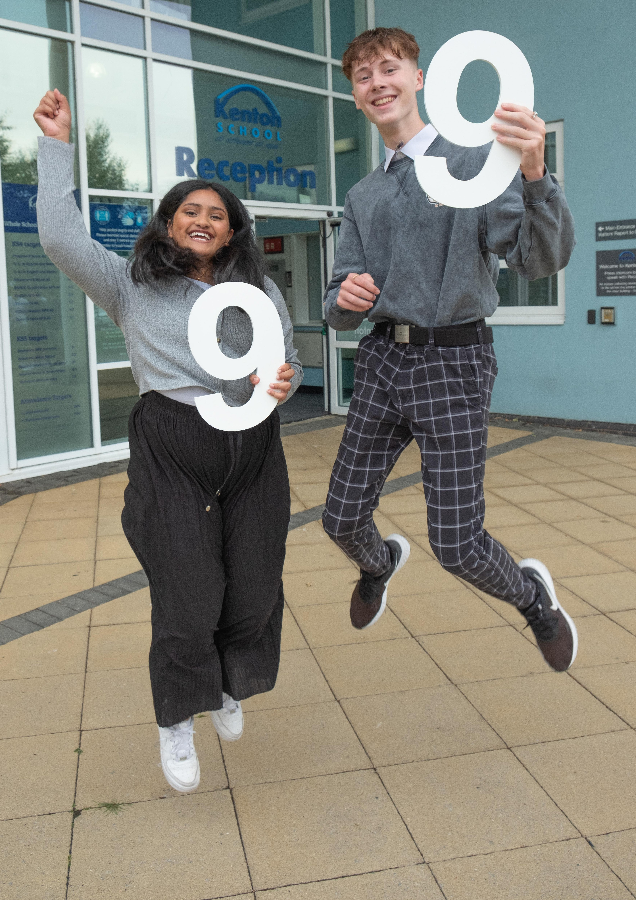
GCSE Results Day
Our 2024 GCSE results reflect the many positive changes that have taken place
in the academy over the last year. All students are given the best possible support and advice and encouraged to follow their passion, whatever that might be.
8

Slide 7
Head of Faculty of Visual and Performing Arts
Person Specification
Part A: Application Stage
The following criteria (experience, skills and qualifications) will be used to short-list at the application stage:
Essential
1 Graduate with Qualified Teacher Status, e.g. PGCE, BEd or equivalent.
2 Proven track record of successful experience in the development of one or more areas of the curriculum.
3 Demonstrable leadership and management experience including a sustained track record of leading a team to achieve outstanding attainment for pupils.
4 Evidence of consistently outstanding classroom teaching.
5 Experience implementing robust quality assurance systems including effective performance management.
6 Evidence of effective assessment and behaviour for learning.
7 Knowledge of the key principles and practices of school effectiveness and improvement.
8 Demonstrable knowledge of Health and Safety requirements in relation to leading a department or faculty including ability to assess and adapt to risks.
9 Experience planning and leading professional learning activities.
10 Effective organisational and ICT skills with the ability to analyse and interpret data to inform practice.
Desirable
11 Proven track record of raising educational standards.
12 Experience in budget and resource management.
13 Evidence of involvement in specific learning and teaching projects.
Part B: Assessment Stage
The following criteria will be further explored at the assessment stage in addition to criteria above.
Essential
1 Appropriate behaviour and attitude towards safeguarding and promoting the welfare of children and young people including:
• Motivation and commitment to work with children and young people
• Ability to form and maintain appropriate relationships and personal boundaries with children and young people
• Emotional resilience in working with challenging behaviours
• Attitude to use of authority and maintaining discipline.
8

Slide 8
Part B Continued
Essential
2 Ability to think and act strategically with sensitivity to organisational and wider political priorities to deliver high quality outcomes.
3 Ability to describe a vision for the development of the faculty and to develop effective plans to implement that vision.
4 Ability to work effectively with a wide range of people, e.g. colleagues, pupils, governor, parents/guardians, other professionals and the wider community.
5 Knowledge of key education legislation and current issues.
6 Ability to present views and opinions in discussion which contribute to positive outcomes including the ability to challenge, give feedback and accept feedback constructively.
7 Ability to demonstrate high expectations and to instill these in others.
8 Appropriate behaviour and attitude towards safeguarding and promoting the welfare of children and young people.
9 Ability and flexibility to take an active part in extra curricular provision.
10 No disclosure about criminal convictions or safeguarding concern that makes applicant unsuitable for this post.
11 Committed to working with young people and contributing to trust ethos.
Assessment/Selection Methods
Lesson observation
Task/s
Part C: Additional Requirements
The following criteria must be judged as satisfactory when pre-employment checks are completed:
1 Enhanced Certificate of Disclosure from the Disclosure and Barring Service*
2 Additional criminal record checks if applicant has lived outside the UK
3 Children’s Barred List Check*
4 DfE Prohibition List Check including GTCE Check
5 Confirmation of Qualifications and Qualified Teacher Status, including confirmation of professional status from relevant professional regulatory body for teachers who have worked overseas.
6 Medical clearance
7 A minimum of two satisfactory references from current and previous employers (or education establishment if applicant not in employment).
8 A Section 128 Education and Skills Act Prohibition from Management list check.
*All posts involving direct contact with vulnerable children are exempt from the Rehabilitation of Offenders Act 1974. The amendments to the Exceptions Order 1975 (2013 and 2020) provide that certain spent convictions and cautions are ‘protected’. These are not subject to disclosure to employers and cannot be taken into account. Guidance and criteria on the filtering of these cautions and convictions can be found on the Ministry of Justice website (www.gov.uk/government/publications/new-guidance-on-the-rehabilitation-of-offenders-act-1974). This post is classed as being in ‘Regulated Activity’ as defined in Keeping Children Safe in Education 2021, therefore in addition to the DBS check, a check of the Children’s Barred List will also be conducted as part of the pre-employment screening process.
9

Slide 9
A-Level Results Day
An increasing number of students spend 7 years at Kenton, going onto a variety of destinations at the end of Year 13. This year we were delighted that students have gone on to study Medicine at Cambridge and History and Physics at Durham as well as Film & TV at the University of Bristol.
12

Slide 10
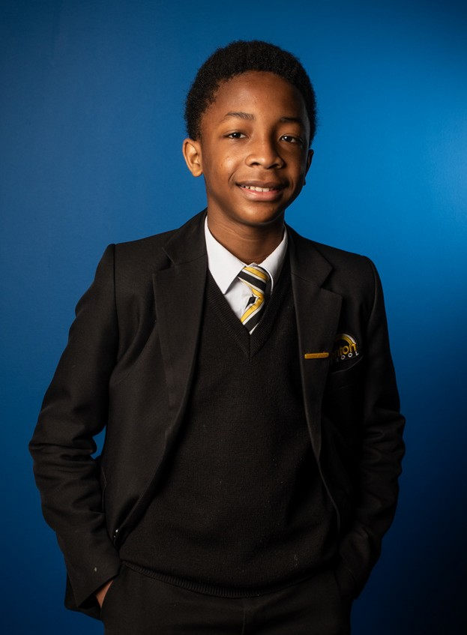
About Kenton School
Kenton School is a vibrant and inclusive secondary school at the heart of the community in which we serve.
With just over 1800 students, Kenton is amongst the largest schools in the North East. However, despite the size, the school prides itself on retaining a family atmosphere, where students feel not only challenged through quality first teaching and learning but supported and motivated by the strong pastoral team.
Our Kenton team are passionate about providing the very best education possible for young people in our city, our region and nationally and our strong and committed team share our vision of ensuring all our students not only reach their potential but that they are confident, happy and resilient students who treat each other with compassion and respect.
We aim to provide a broad curriculum, focussing on educating our students for their future in the modern world, not the past or even just the present. We also believe strongly in developing the creativity of our students and this is demonstrated through our commitment to delivering arts courses as a core subject.
For further information, please visit our website
www.northernleaderstrust.org
12

Slide 11
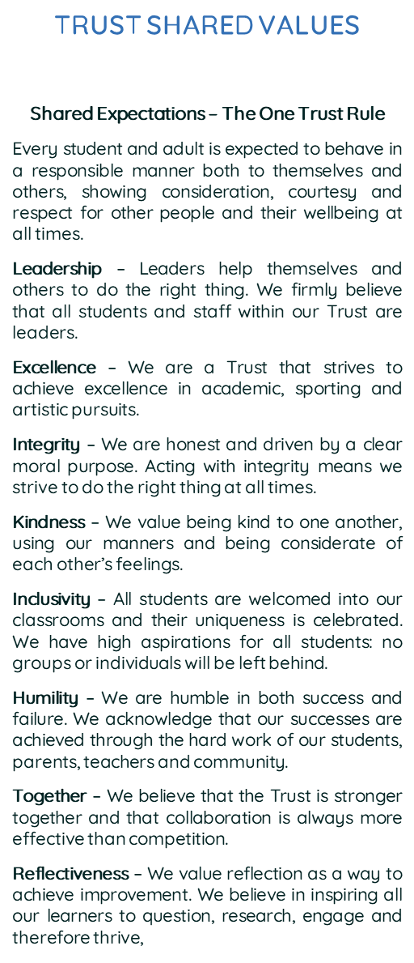
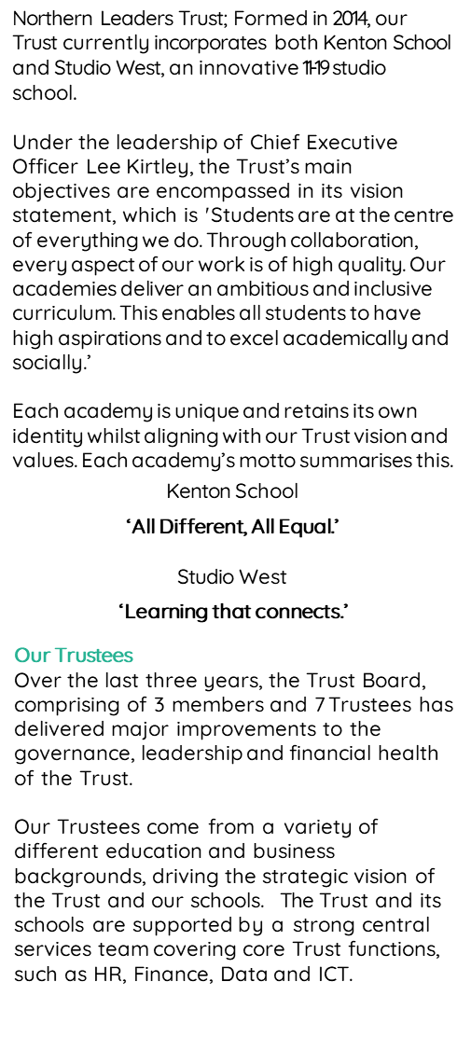
About our Trust
12

Slide 12
Additional Information for Applicants
Conditions of Service
The conditions of service applicable to this post are the Conditions of Service for School Teachers in England and Wales (the Burgundy Book) and the School Teachers Pay and Conditions document as amended/supplemented by local decisions made by Northern Leaders Trust.
Pay and Grading
The salary range for the post is M/UPR £30,000 to £46,525 plus TLR1b £11,408 pa. Salary will be dependent upon current pay point and relevant experience.
Progression through the salary range is considered annually and is subject to successful performance appraisals and meeting progression criteria.
Status
This is a permanent post.
Pension Scheme
The postholder will be automatically enrolled in the Teachers’ Pension Scheme. Further details can be found at www.teacherspensions.co.uk.
Equal Opportunities
Northern Leaders Trust is opposed to any form of unfair discrimination and is publicly committed to be an equal opportunity employer.
Safeguarding
Northern Leaders Trust is committed to safeguarding and promoting the welfare of children and young people and expects all staff and volunteers to share this commitment. We are fully committed to ensuring that consistent effective safeguarding
procedures are in place to support families, children and staff at school.
Rehabilitation of Offenders
All posts involving direct contact with vulnerable children are exempt from the Rehabilitation of Offenders Act 1974. The amendments to the Exceptions Order 1975 (2013 and 2020) provide that certain spent convictions and cautions are ‘protected’. These are not subject to disclosure to employers and cannot be taken into account. Guidance and criteria on the filtering of these cautions and convictions can be found on the Ministry of Justice website www.gov.uk/government/ publications/new-guidance-on-the-rehabilitation-of- offenders-act-1974.
13

Slide 13
Application Process
If you feel you have the experience, skills and attributes to succeed as part of our team, please download and complete our application form and return it to hr@northernleaderstrust.org
Kenton School, Drayton Road, Newcastle upon Tyne, NE3 3RU
Studio West, West Denton Way, Newcastle upon Tyne, NE5 2SZ

